Slide 1
Introduction
Chapter1 – part1

Slide 2
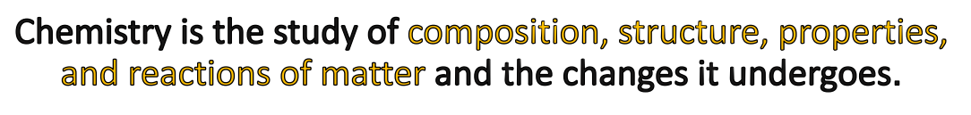
What is Chemistry?

Slide 3
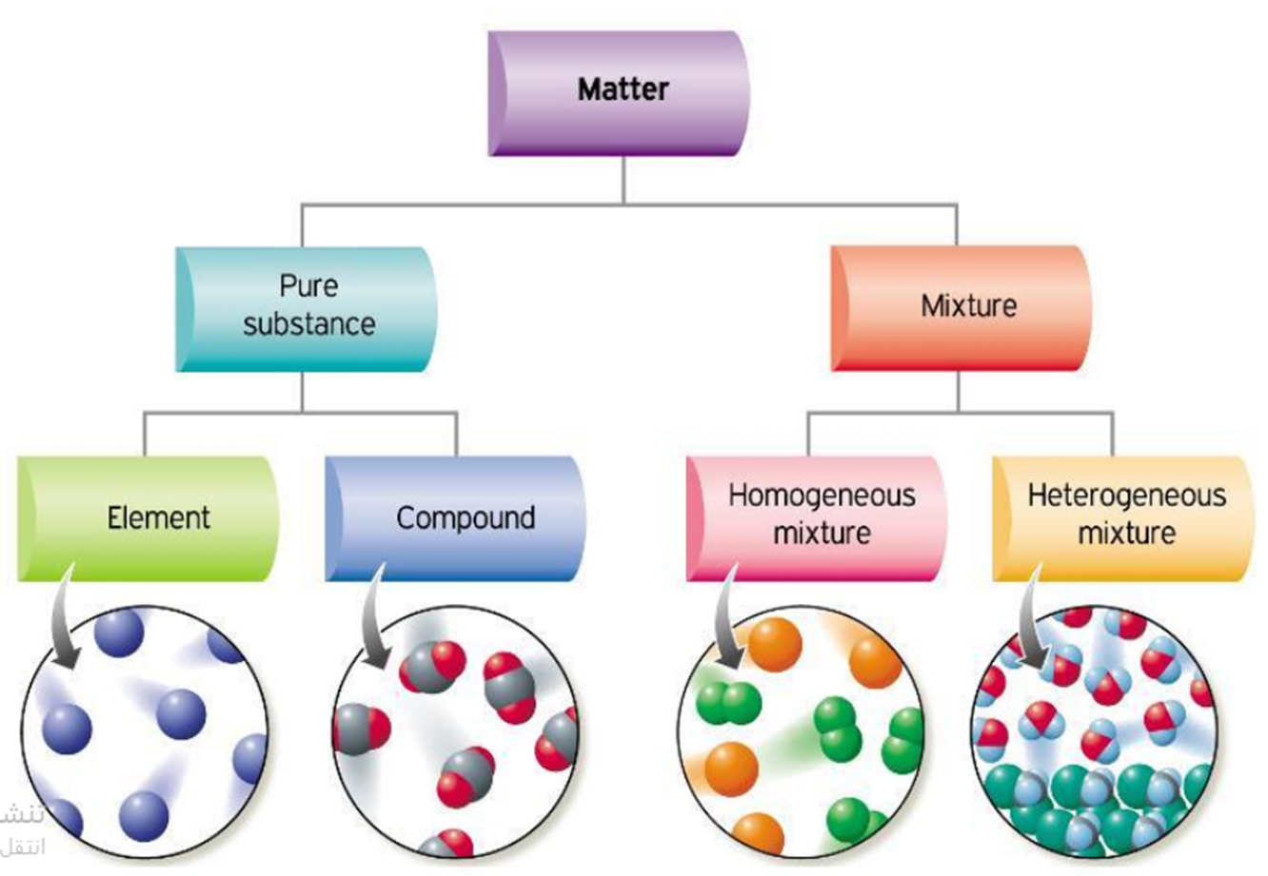
Matter
Matter is made up of basic “ingredients” known as atoms.
• An atom is the smallest unit of an element that
maintains the properties of that element.

Slide 4
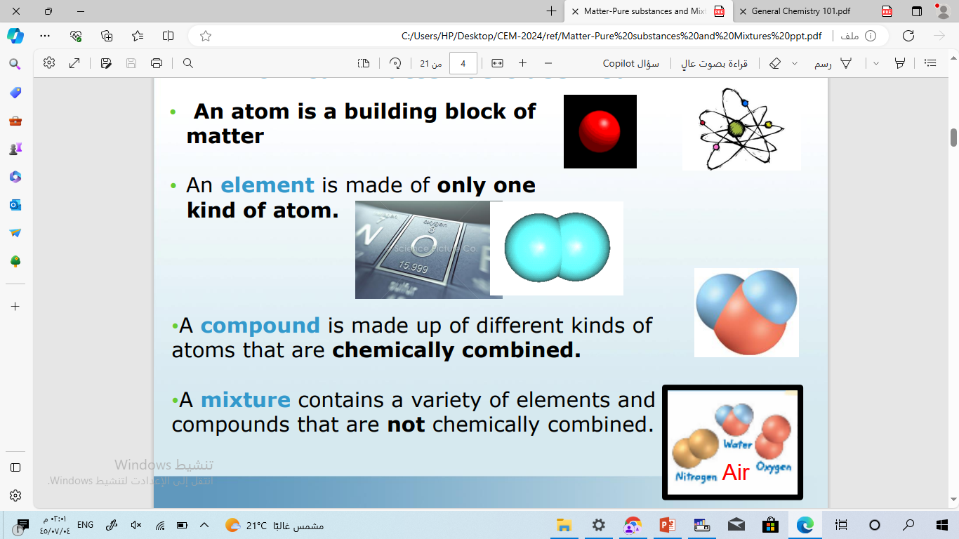
Matter
Substances are classified as elements and compounds.
An element is made of only one kind of atom.
A Molecule of element is made of only one kind of atom.
A Molecule of compound is made up of different kinds of atoms that are chemically combined.

Slide 5
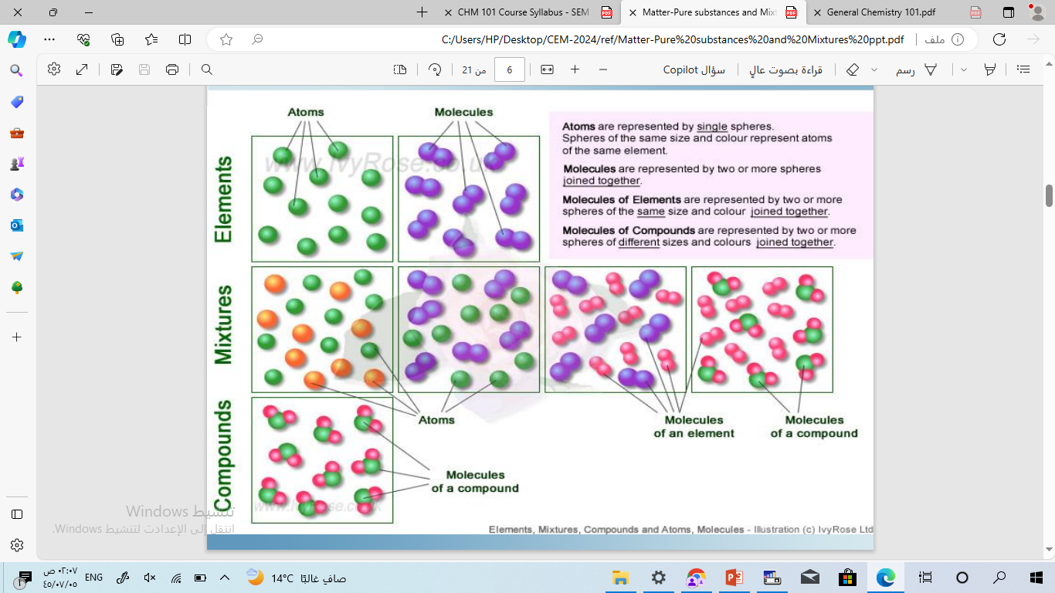

Slide 6
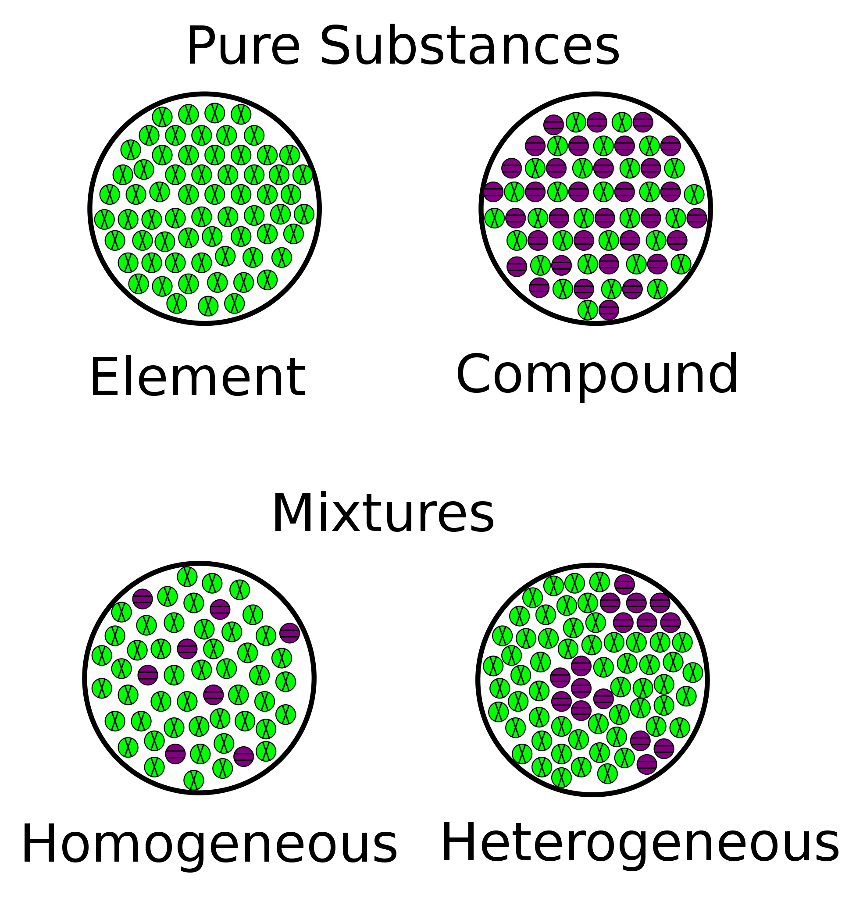
What are pure substances?
A pure substance is a substance with definite physical and chemical properties.
Pure substances are made up of just one type of particle.
Element, molecule and molecule of Compounds are Pure substances

Slide 7
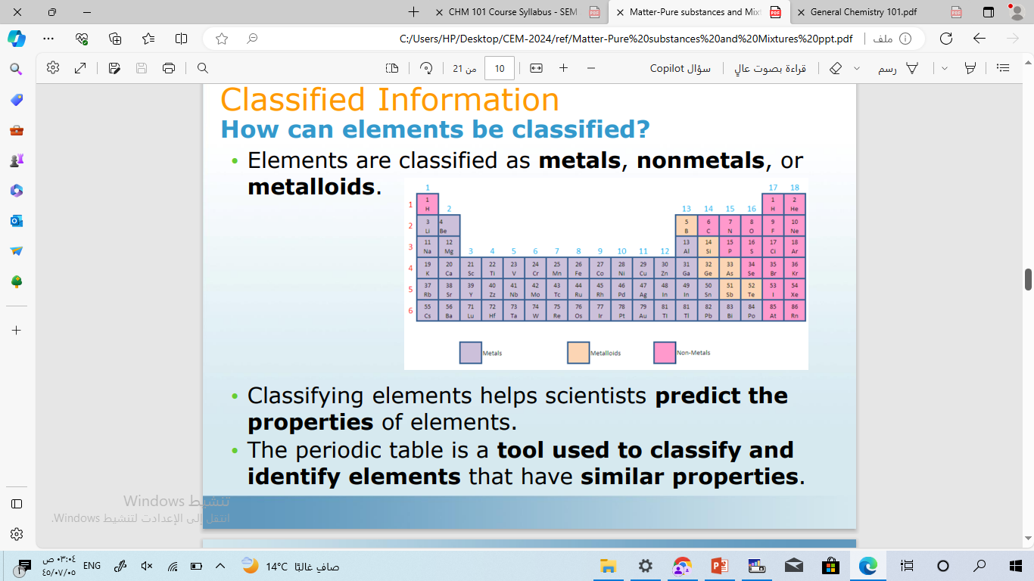
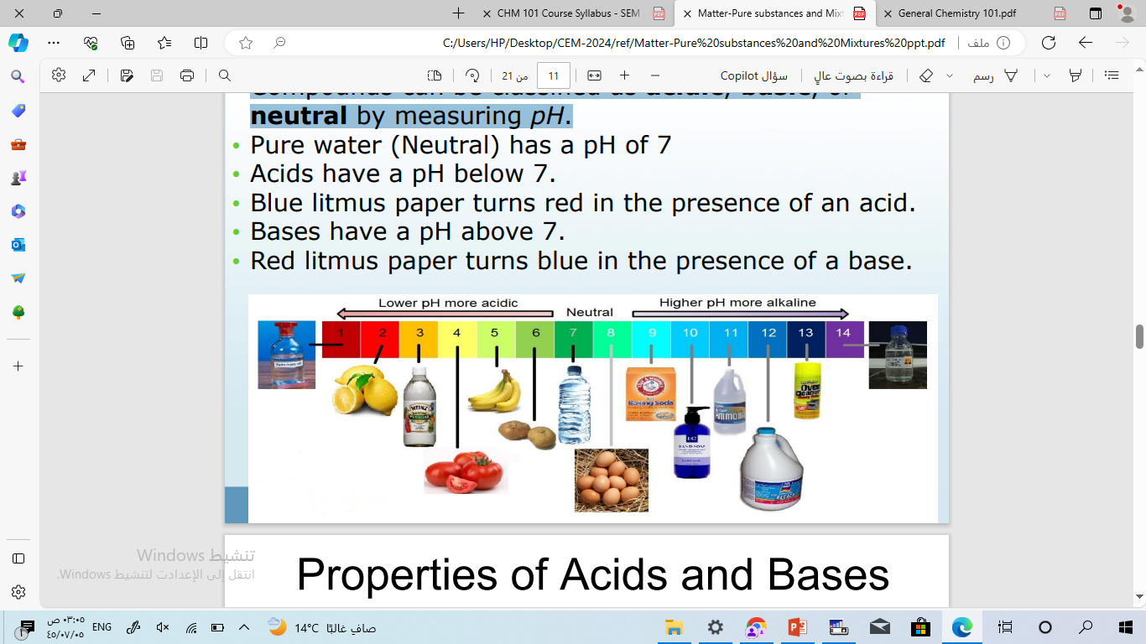
How can pure substance be classified?
pure substance
2- Molecule
1- Elements
Molecule of element
Molecule of compound
Elements are classified as metals, nonmetals and metalloids
A- Compounds can be classified as acidic, basic, or neutral by measuring pH.
B- Compounds can be organic or inorganic.

Slide 8
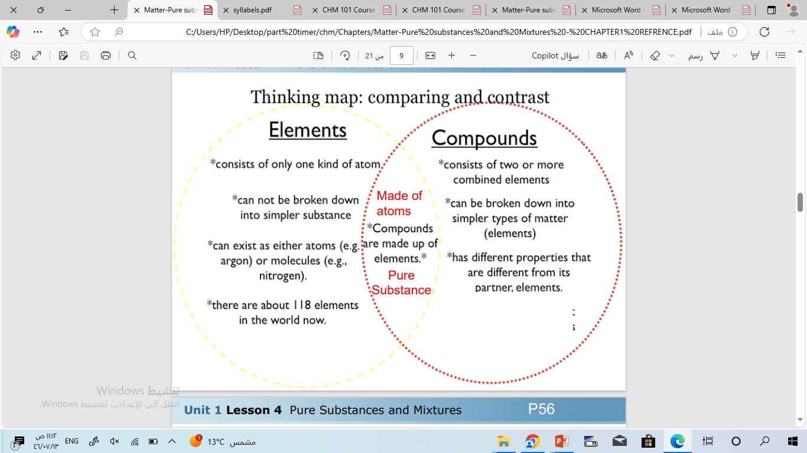
How can pure substance be classified?

Slide 9
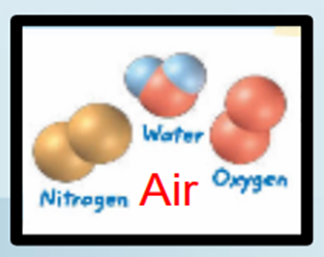
What are mixtures?
A mixture is a combination of two or more substances that are combined physically but not chemically.
Mixtures are not pure substances and do not have definite properties.
Mixtures can be separated by physical changes.

Slide 10
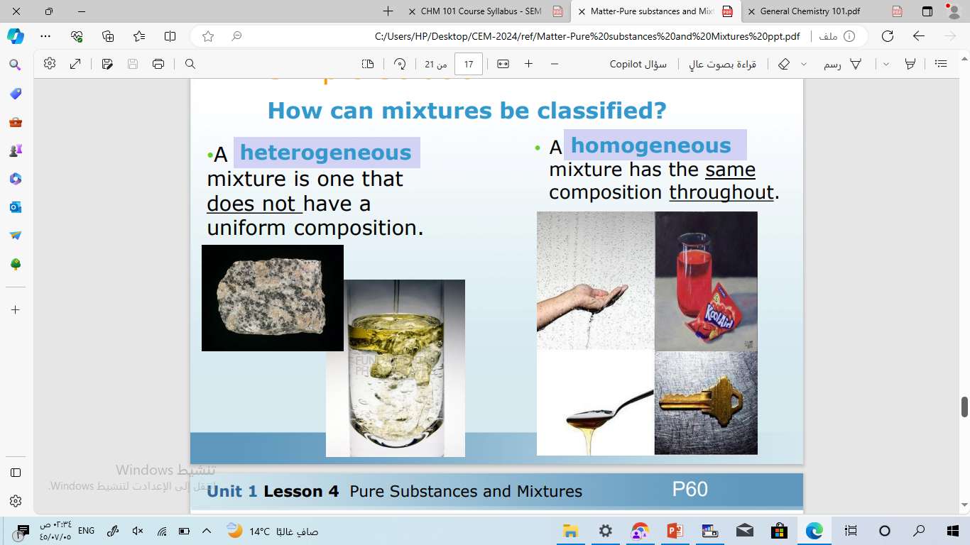
How can mixtures be classified?
Mixtures
1- A heterogeneous mixture is one that does not have a uniform composition.
2- A homogeneous mixture has the same composition.
Suspension
Such as flour suspended in water
Colloids such as milk
Solution such as salt dissolve in water
https://www.youtube.com/watch?v=mq_2WN0s6L0

Slide 11
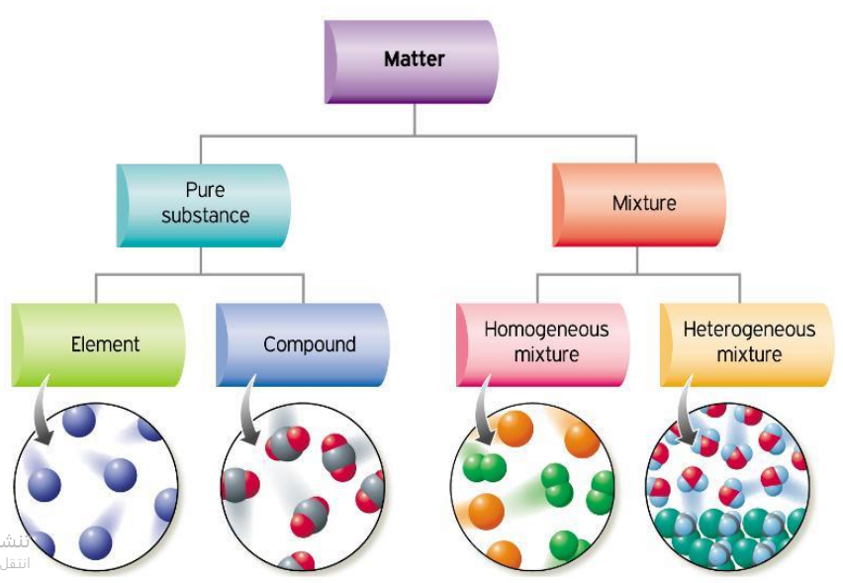
Summary

Slide 12
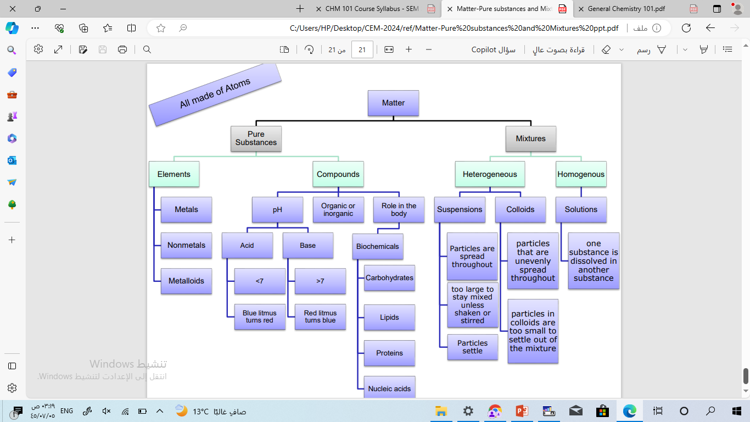
Summary

Slide 13
Physical an chemical properties of matter
Chemical Properties
are any of the properties of matter that can be observed and measured only by performing a chemical change or chemical reaction
Chemical reactions allowed!

Slide 14

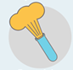
Physical an chemical properties of matter
Chemical Properties
Flammability - Material’s ability to burn in the presence of oxygen
Reactivity - How readily a substance combines chemically with other substances

Slide 15
Physical and chemical properties of matter
Physical properties are properties that can be measured or observed without changing the identity of the substance.
No chemical reactions allowed!

Slide 16
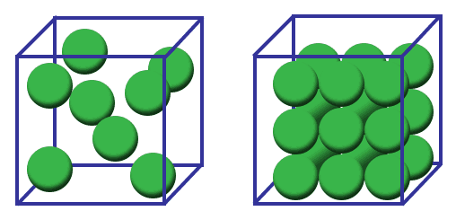
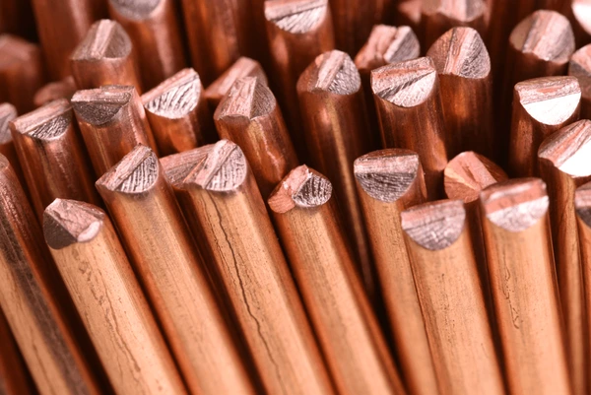
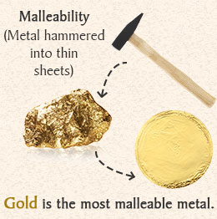

Physical an chemical properties of matter
Physical properties
3- Conductivity - Material’s ability to allow heat or electricity to flow
1- Density - Mass/volume
4- Malleability - The ability of a substance to be rolled or pounded into thin sheets.
2- Color – how the object absorbs and reflects light

Slide 17
Intensive and Extensive of physical Properties
Intensive and Extensive of physical Properties
There are two types of physical properties:
Extensive Properties
Intensive Properties
Extensive properties are directly related to the size/amount of a sample.
Intensive properties are NOT related to the size or amount of a sample.

Slide 18
All the extensive properties!
M
V
L
M
E
N
ass
olume
ength
oles
nergy
umber of particles

Slide 19
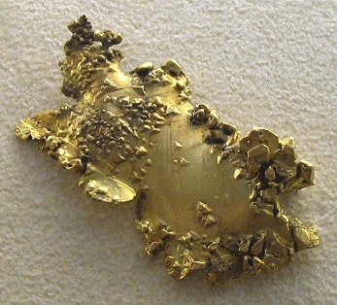
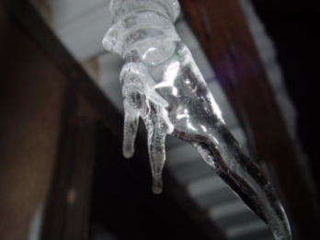
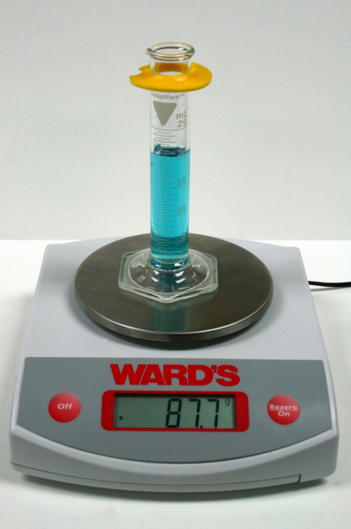
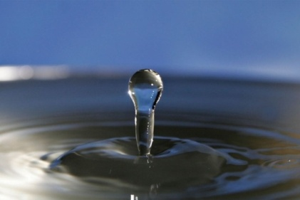
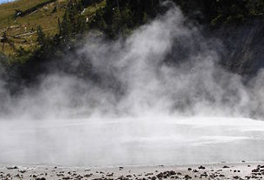
There are MANY intensive properties that are NOT related to the size of a sample. Because this list is much larger, you should focus on remembering the shorter extensive list.
1- Color
2- State of Matter
3-Density

Slide 20
Decide if the following physical properties are intensive or extensive:
Intensive
(NOT related to size)
Extensive
(Related to size)
color
odor
melting point
mass
boiling point
volume
density
length
specific heat
temperature
energy
state of matter

Slide 21
Physical and Chemical Change
Physical Changes
Physical Changes - a change that occurs without changing the identity of the substance.
NO new substances are formed.
Chemical Changes
Chemical Changes - a change that occurs that causes the identity of a substance to change; something New is formed.
New substances with new properties are formed

Slide 22
Differences Between Physical and Chemical Change
Physical Change | Chemical Change
The composition remains the same. | Involve the formation of new substances.
Physical change is a temporary change. | Chemical change is a permanent change.
A Physical change affects only physical properties i.e. shape, size, etc. | Chemical change both physical and chemical properties of the substance including its composition
Some examples of physical change are freezing r, melting, boiling, etc. | A few examples of chemical change are Flammability and Reactivity, etc.
Generally, physical changes do not involve the production of energy. | Chemical changes usually involve the production of energy (which can be in the form of heat, light, sound, etc.)
In a physical change, no new substance is formed. | A chemical change is always accompanied by one or more new substance(s).
Physical change is easily reversible i.e original substance can be recovered. | Chemical changes are irreversible i.e. original substance cannot be recovered.

